Slide 1

UK CRIME ANALYSIS
Vishal Pathak (George Washington University)

Slide 2
INtroduction
CRIME ANALYSIS HAS ALWAYS BEEN A FASCINATING AREA FOR STATISTICS AND ML RESEARCHERS IN LAST DECADE. ONE SUCH AREA HAS DEVELOPED HOW CRIME & CRIME PATTERNS CHANGES WHEN PANDEMIC HITS WORLD.

Slide 3
TABLE OF CONTENTS
1) PROBLEM STATEMENT
2) DATASET DETAILS
3) DATA ANALYSIS
4) OBSERVATIONS
5) MODEL RESULTS
6) CHALLENGES FACED
7) CONCLUSION
8) FUTURE WORK

Slide 4
Problem statement
1) COMPARE CRIMES PRE AND POST PANDEMIC
Observe Patterns
Observe frequency
Observe changes
2) Predicting whether person will be charged as guilty
Find features
Observe any peculiar pattern
Needs to be done with lightweight models

Slide 5
DATA SET DETAILS
DATA SOURCE : https://data.police.uk/data
DATATYPES AVAILABLE :
1) STREETS
2) OUTCOMES
3) STOP & SEARCH
STREETS :
PRE COVID : 13185655 ROWS, 12 COLUMNS
POST COVID : 9155768 ROWS , 12 COLUMNS
OUTCOMES :
13011476 ROWS, 10 COLUMNS

Slide 6
DATA CLEANING TECHNIQUES USED
OUTLIER TREATMENT
MISSING VALUE TREATMENT
SKEWNESS
DUMMY VARIABLES
FEATURE TRANSFORMATION
NEW FEATURE CREATION FROM EXISTING COORDINATES

Slide 7
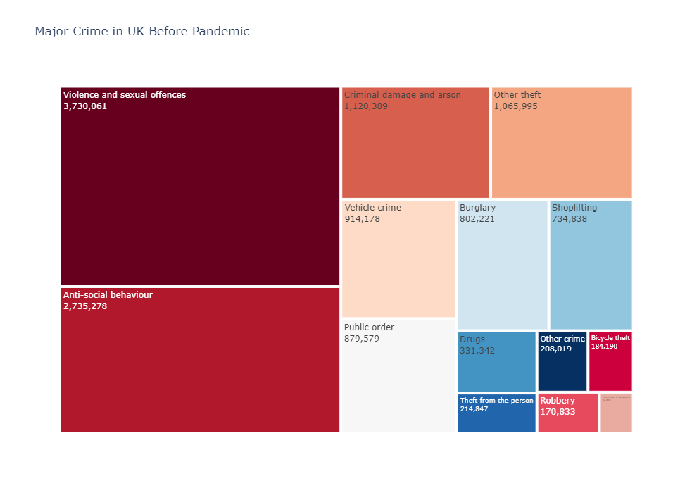
PRE PANDEMIC

Slide 8
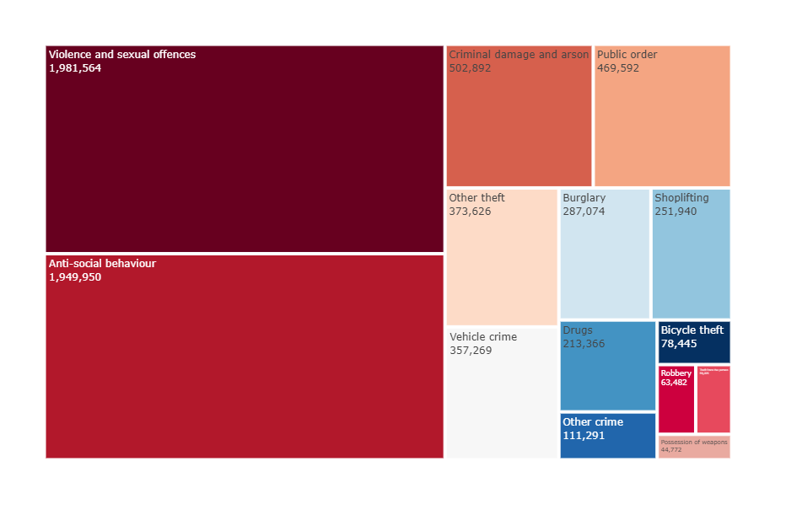
POST PANDEMIC

Slide 9
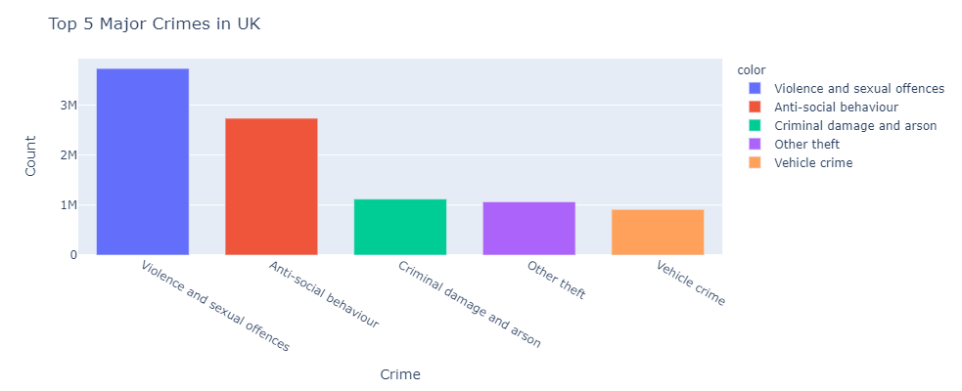
OBSERVATION 2 PRE PANDEMIC

Slide 10
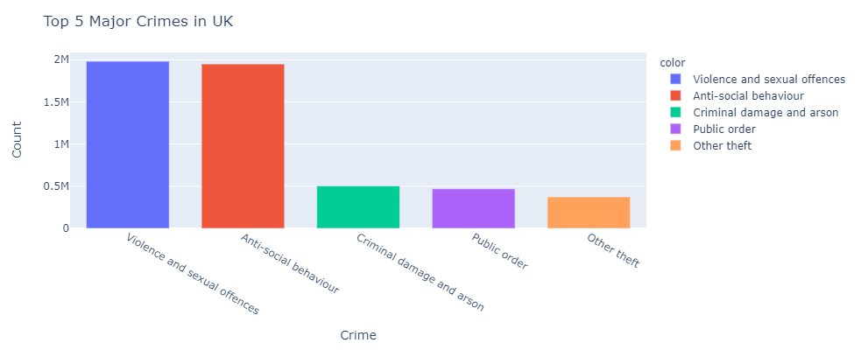
POST PANDEMIC

Slide 11
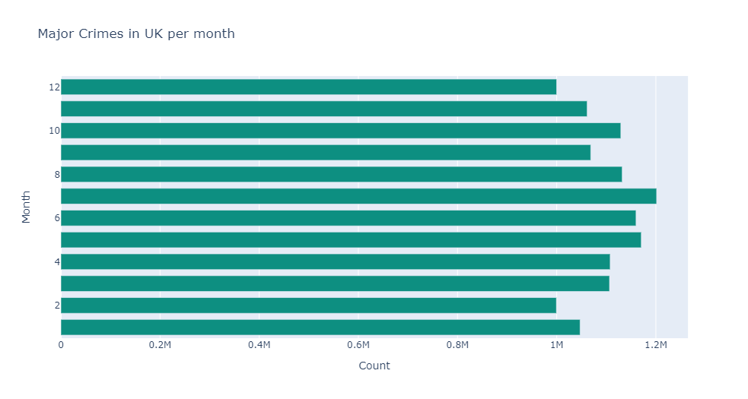
OBSERVATION 3 PRE-PANDEMIC

Slide 12
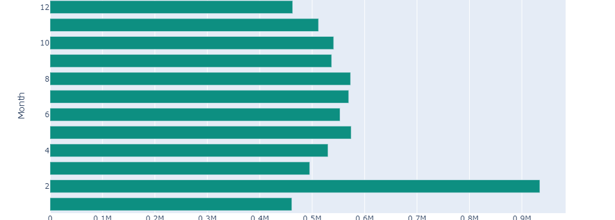
POST PANDEMIC

Slide 13
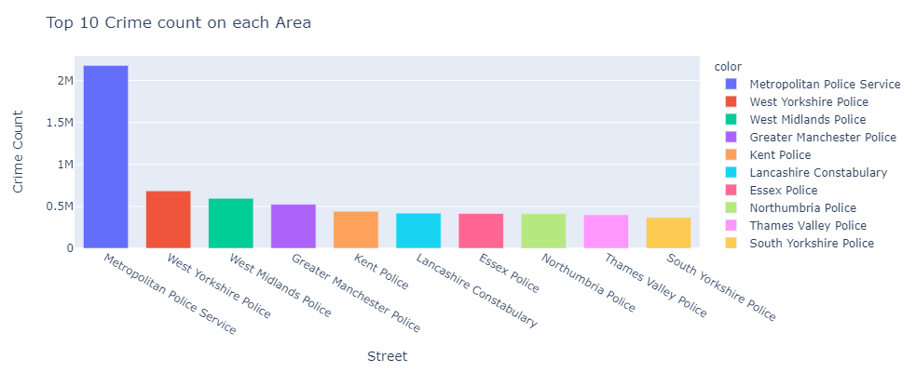
OBSERVATION 4 Pre-PANDEMIC

Slide 14
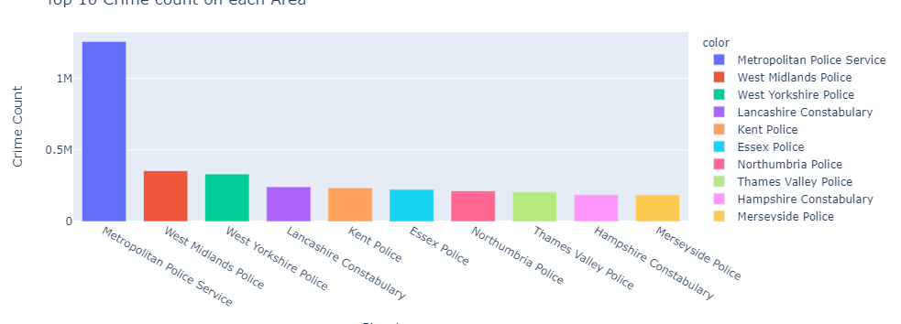
POST PANDEMIC

Slide 15
MODELLING RESULTS
LOGISTIC : 78%
DT : 81%
GBT : 83 %
LGBT : 84 %

Slide 16
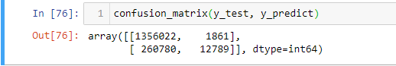
CONFUSION MATRIX

Slide 17
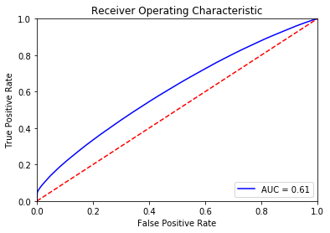
AUC CURVE

Slide 18
CHALLENGES FACED
1) DIRTY DATA
2) DATA UNDERSTANDING
3) PECULIAR OBSERVATIONS
4) COMPUTATIONAL POWER & ANALYSIS

Slide 19
CONCLUSION
EXPECTED RESULTS.
MODEL JUSTIFIES OUR ASSUMPTIONS
SCOPE OF IMPROVEMENT

Slide 20
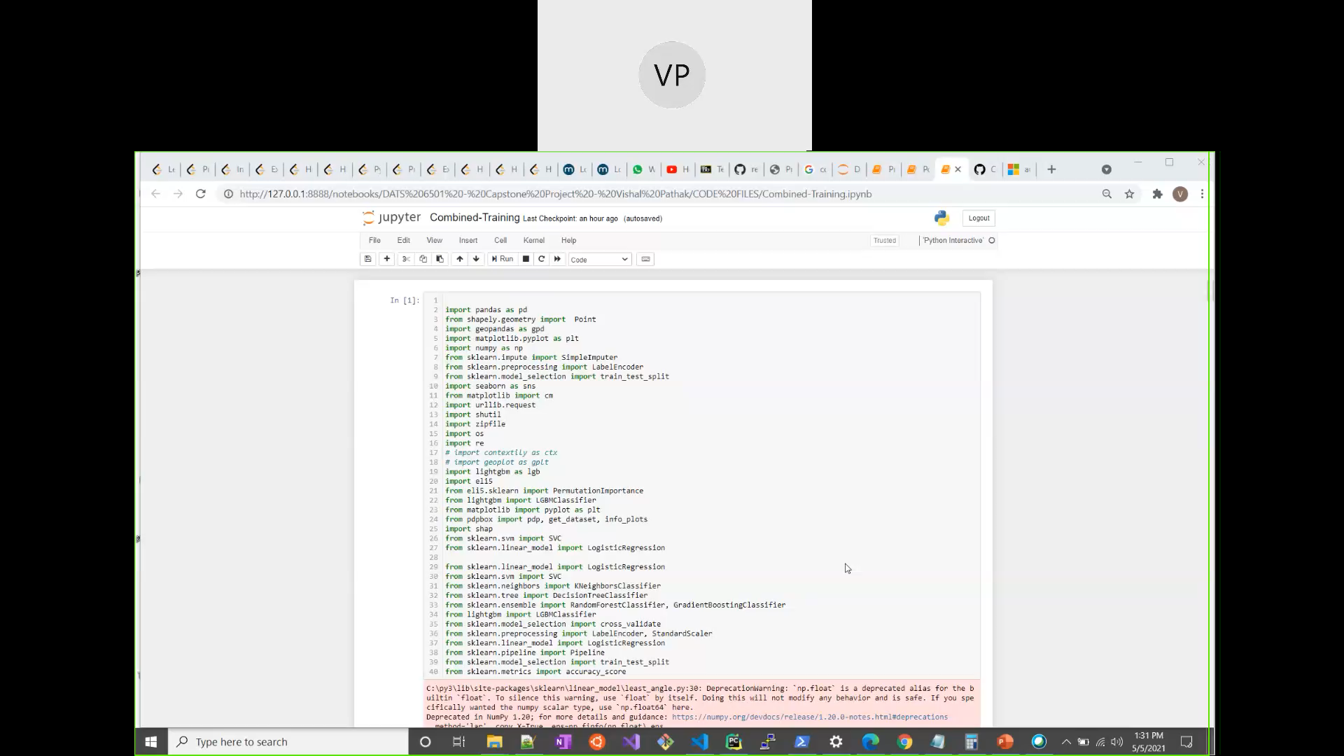
CODe REview

